Slide 1
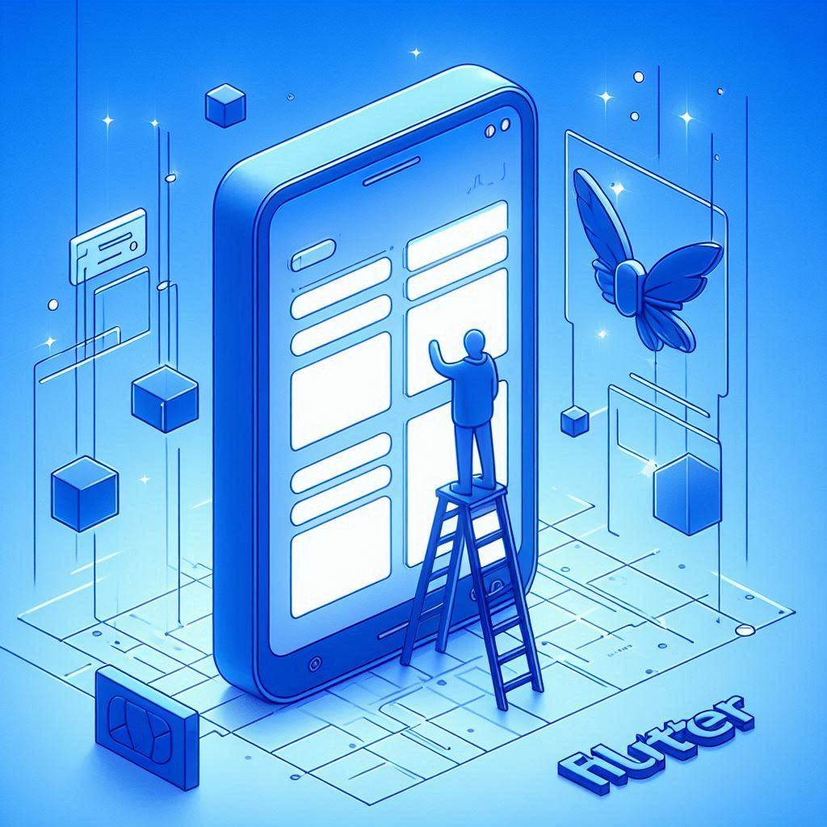
State Management
Prepared & presented by Amira Nasser
amira20nasser@gmail.com
LinkedIn
Amira Nasser | Facebook

Slide 2
Today, you’ll learn about
1.
2.
3.
4.
Types of State
State Management Methods
River pod with Flutter
What’s State?

Slide 3
What is state?
Data in an app is displayed at any given moment
The user interface is built by the current state of the app. When the state of a Flutter app changes, it'll trigger the re-draw of the user interface. This is called Declarative UI.
Notes:
state refers to the data that determines how a user interface (UI) should be displayed at any given moment

Slide 4
Types of
state
amira20nasser@gmail.com
LinkedIn
Amira Nasser | Facebook
Notes:
Ephemeral – App state

Slide 5
1.
Ephemeral State
Example:
Ephemeral or (local) state is responsible for managing data that is local to a particular widget or UI component. It includes properties like text, content.
Managed by StatefulWidget
These widgets have associated mutable state that can change over time in response to various events.
counter widget
In a counter widget, the count value would be an example of ephemeral state, as it is specific to that particular widget and does not need to be shared with other parts of the application.

Slide 6
2.
App State
App or (global) state is responsible for managing data that is shared and accessed by multiple widgets or different parts of the application. It includes information like user authentication status, theme settings, navigation state.
Managed by State Management Techniques.

Slide 7
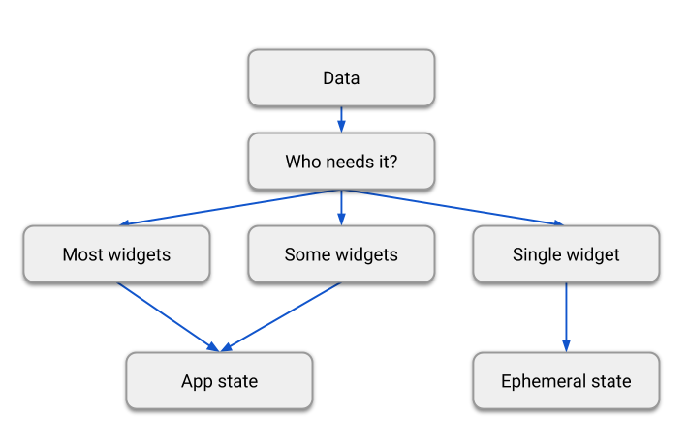

Slide 8
some State Management Techniques
1
River pod
2
Bloc (cubit- Bloc )

Slide 9

River pod
is a library for Flutter that allows you to manage your app’s state in a more efficient and scalable way.
manage state in Flutter without using setState. you can declare a value or a class that can be accessed by other parts of your app.

Slide 10
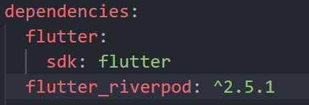
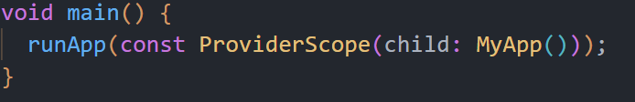
Getting Started with Riverpod
Add the flutter_riverpod dependency to your pubspec.yaml file
Enable River pod for the entire project

Slide 11
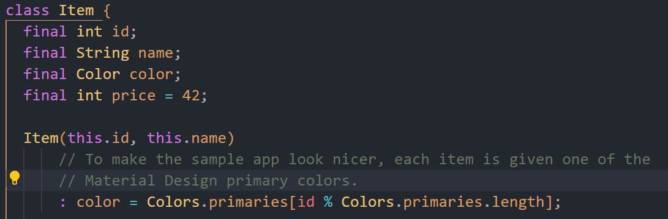
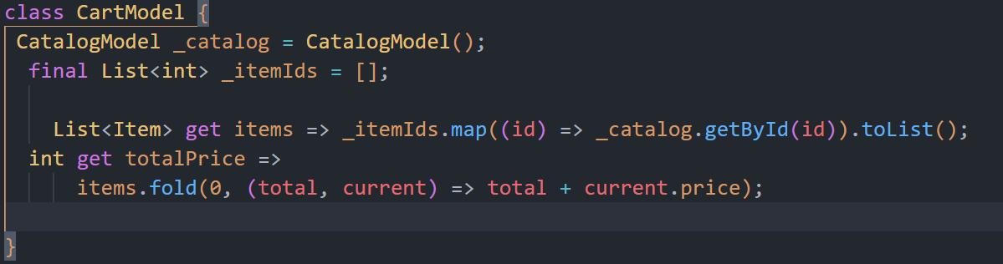
cont. River pod
Determine Models in the app

Slide 12
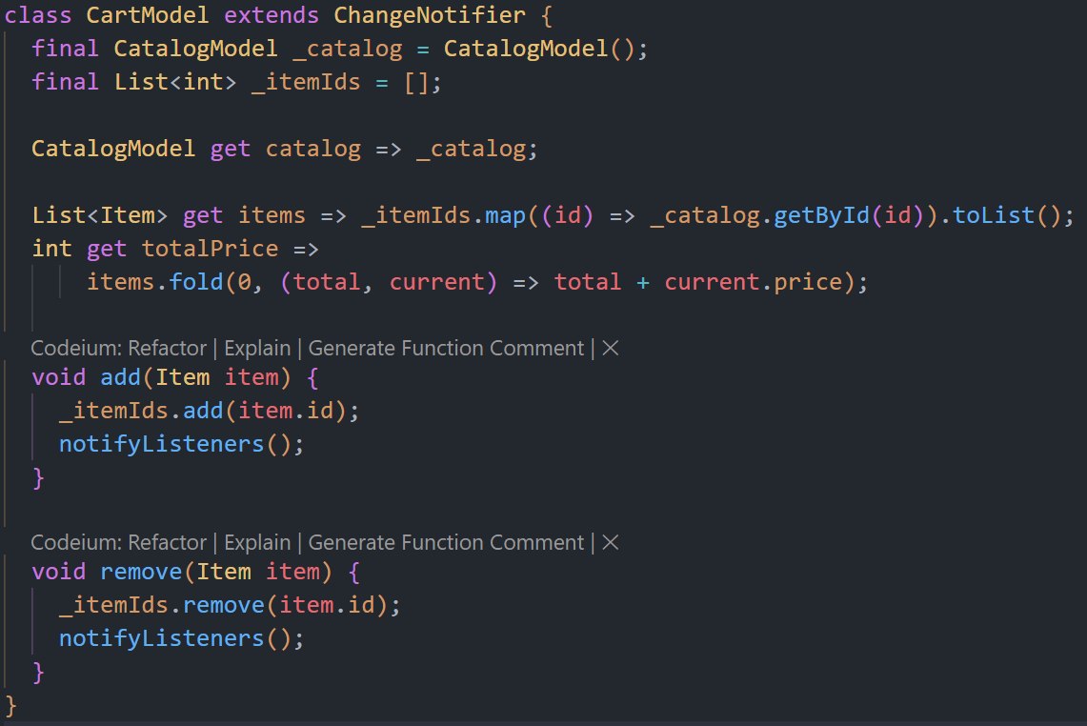
cont. River pod
When does the app trigger? (when add the item to the cart?)
When press add /remove , so we need to add function to inform that state is changes

Slide 13
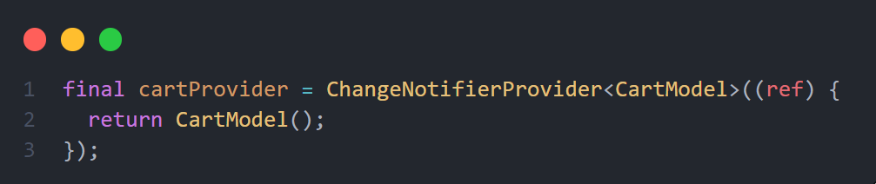
Then, Create your provider

Slide 14
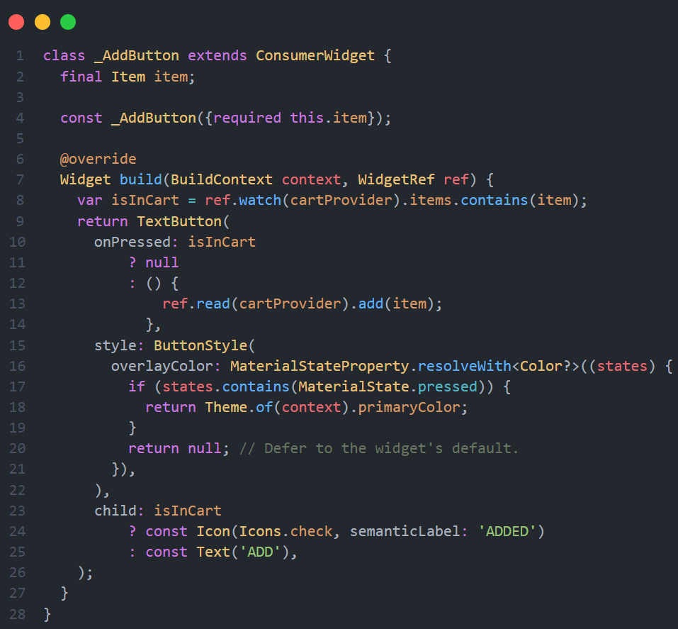
When do you call the add function? (when ask the UI to rebuild?)

Slide 15
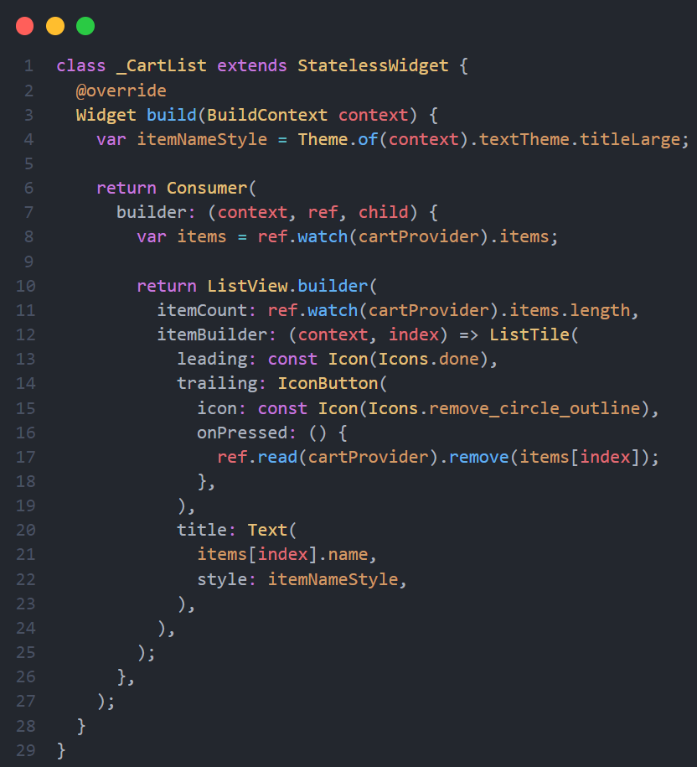
When do you call the remove function? (when ask the UI to rebuild?)

Slide 16
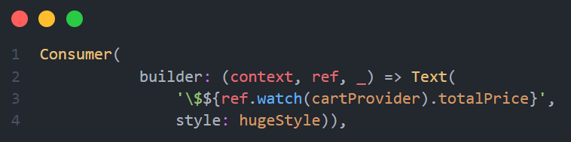
You can Wrap the widget that you need to rebuild with Consumer Widget.

Slide 17

The end of a session doesn’t mean the end of learning. In fact, it often marks the beginning of new opportunities for growth and exploration. 🌟

Slide 18
Is that all in River pod?
No, You can know more about river pod from documentation
Extra Resources
StateProvider | Riverpod
StateNotifierProvider | Riverpod
ChangeNotifierProvider | Riverpod
Flutter Riverpod Tutorial – The Better Provider - Reso Coder
Contact
amira20nasser@gmail.com
LinkedIn
Amira Nasser | Facebook

Slide 19

amira20nasser@gmail.com
LinkedIn
Amira Nasser | Facebook

